Slide 1
Cancer cell Classification
Faculty Coordinator – Mrs. Shubha
Team Members :-
Manognya Lokesh Reddy- 1BI20AI029
Vikhyath - 1BI20AI054

Slide 2

Abstract
Cancer cell classification is a critical aspect of cancer diagnosis and treatment planning. Traditional methods often rely on labor-intensive and subjective analysis, leading to variability in results. The integration of machine learning (ML) techniques has emerged as a promising approach to enhance the accuracy and efficiency of cancer cell classification. This paper reviews recent advancements in ML-based methodologies applied to the classification of cancer cells, encompassing diverse data sources such as imaging, genomics, and proteomics. Various algorithms, including deep learning, support vector machines, and random forests, are explored for their efficacy in distinguishing between different cancer cell types and subtypes. The integration of multi-omics data and the development of feature extraction techniques play a pivotal role in improving the robustness and generalization of these models. Additionally, challenges, such as data heterogeneity and interpretability, are discussed, along with potential solutions and future directions. The application of ML techniques in cancer cell classification not only holds promise for more accurate and timely diagnoses but also opens avenues for personalized treatment strategies, ultimately contributing to advancements in precision oncology.

Slide 3
Introduction
Cancer, a complex and multifaceted group of diseases, continues to pose significant challenges in both diagnosis and treatment. In the pursuit of more precise and efficient diagnostic tools, the integration of machine learning techniques has emerged as a promising avenue. This project focuses on the pivotal task of cancer cell classification, leveraging the power of machine learning to enhance accuracy and speed in the identification and characterization of malignant cells. Traditional methods of cancer diagnosis, while valuable, often face limitations in terms of sensitivity and specificity. The advent of machine learning offers a paradigm shift by harnessing the capability to discern intricate patterns and subtle nuances in cellular data. This project aims to harness the potential of advanced algorithms and computational models to create a robust system for the classification of cancer cells, with a primary emphasis on improving early detection and streamlining diagnostic processesThe integration of deep learning architectures, such as convolutional neural networks (CNNs), will enable the system to extract high-level features and patterns, facilitating more accurate and nuanced classifications.The implications of successful cancer cell classification using machine learning techniques are profound. Not only does it hold the promise of enhancing diagnostic precision, but it also opens avenues for personalized treatment strategies and contributes to our understanding of the underlying biological mechanisms driving cancer progression.

Slide 4
Literature Survey
SL NO. | AUTHORS NAME AND YEAR OF PUBLICATION | Title name and Journals name | Abstracts or objects | Technique used | Limitation
1 | Cruz-Roa A. 2018 | "Automatic Detection of Invasive Ductal Carcinoma in Whole Slide Images with Convolutional Neural Networks." | automatic detection of invasive ductal carcinoma in whole slide images using Convolutional Neural Networks (CNNs). | CNN | Limitations may include the need for extensive computational resources.
2 | Shao W., 2019 | "A New SVM-Based Method for Identifying the Origins of Malignant Tumors at the Cellular Level." | Support Vector Machine (SVM)-based approach to identify the origins of malignant tumors at the cellular level. | SVM | Specific to bounding box detection in histopathological images
3 | Janowczyk A., 2019 | "Deep learning for digital pathology image analysis: A comprehensive tutorial with selected use cases." | in-depth exploration of deep learning techniques in digital pathology, including cancer cell classification. | Decision tree classification | Limitations might include interpretability and computational demands.
4 | Wang X., 2016 | "Deep Learning for Identifying Metastatic Breast Cancer." | utilizes deep learning methods for identifying metastatic breast cancer in pathology images. | ANN, Random forest | Limitations could involve dataset biases and the need for annotated data.

Slide 5
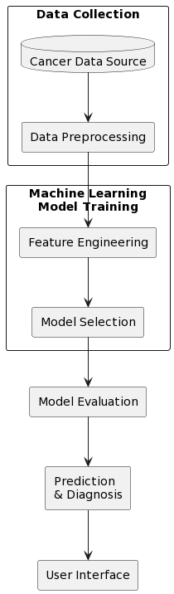
Proposed System
The system employs machine learning techniques to analyze cancer-related data, encompassing data preprocessing, model training using diverse algorithms (such as Logistic Regression, SVM, Decision Trees), and evaluation metrics. It aims to accurately classify cancer cells as benign or malignant, aiding in early detection and treatment decision-making. Additionally, it includes a user-friendly interface for inputting data and receiving predictive results, ensuring ease of use for medical professionals.

Slide 6
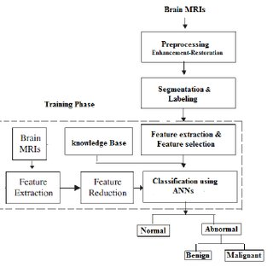
Preprocessing Enhancement Restoration:
Refines raw cancer cell data through techniques like noise reduction, feature scaling, and handling missing values, ensuring cleaner and more uniform data for model training. Utilizes methods like feature engineering and image enhancement to accentuate relevant cell characteristics, aiding in the restoration of informative features, and potentially enhancing model interpretability and predictive accuracy.
Feature extraction and selection:
Involves extracting pertinent information from cancer cell data, such as cell morphology, texture, and spatial arrangements, to capture crucial characteristics for distinguishing between benign and malignant cells. Utilizes techniques like statistical analysis or model-based selection to identify the most informative features, reducing dimensionality and enhancing model efficiency while retaining discriminative power in distinguishing cancer cell types.
Classification using ANNs:
ANNs leverage intricate interconnected layers to recognize intricate patterns within cancer cell data, enabling them to capture nonlinear relationships and nuances crucial for accurate classification.
ANNs dynamically adjust their internal parameters through iterative training, enabling them to adapt and learn representations of cancer cell features, potentially leading to robust and accurate classification outcomes.
Block Diagram

Slide 7
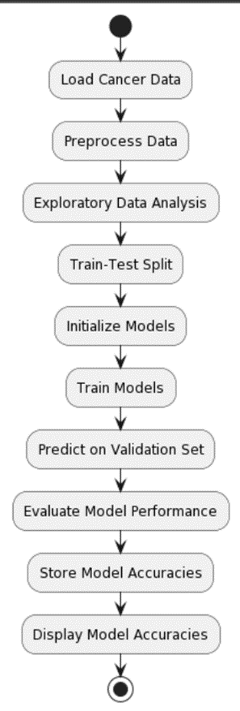
Data Loading and Examination: Provides functionalities to load cancer-related data from a CSV file, inspecting its structure, and identifying any missing values or anomalies.
Data Preprocessing and Visualization: Implements data cleaning steps, handling missing values, converting categorical data to numerical format, and visualizing critical insights. The visualization tools include pie charts for diagnosis distribution, countplots for diagnosis frequency, scatter plots to reveal feature relationships, and heatmaps displaying feature correlations.
Feature Analysis and Insights: Offers tools to analyze key features' relevance to cancer diagnoses, specifically examining mean radius and texture mean concerning benign and malignant diagnoses.
Model Training and Evaluation: Integrates various machine learning algorithms (Naive Bayes, Linear Discriminant Analysis, Logistic Regression, Support Vector Classifier, Extra Trees Classifier) to construct predictive models. These models are trained on a segmented dataset and assessed for accuracy using a validation set, allowing users to compare performance across different algorithms.
Diagnostic Outcome: Provides a predictive tool for clinicians or researchers to anticipate cancer diagnoses based on input features, aiding in early detection and decision-making.
.
System Architecture

Slide 8
System Requirements
Hardware Requirements:
Software Requirements:
-CPU : Processor i5 or more
-RAM : 8GB
-Operating System
-Jupyter Notebook
-Anaconda Navig
-Python 3.8
Non Functional Requirements
Hardware Compatibility: The system's performance may be constrained by the hardware capabilities of the devices on which it is deployed. Older or less powerful hardware may experience slower processing speeds and could impact the real-time nature of face detection.
Data Availability and Quality: The project's success heavily relies on the availability and quality of labeled datasets for training and testing the machine learning models. Limited or poor-quality data may result in suboptimal model performance and generalization.
Computational Resources: Adequate computational resources are essential for training complex machine learning models, especially deep neural networks. Constraints in computational power may impact the scalability and efficiency of the developed system.
Time Constraints: Timely completion of the project is crucial, especially in the context of medical applications where prompt diagnosis is critical. Delays in model development and deployment may hinder the project's overall impact on healthcare.

Slide 9
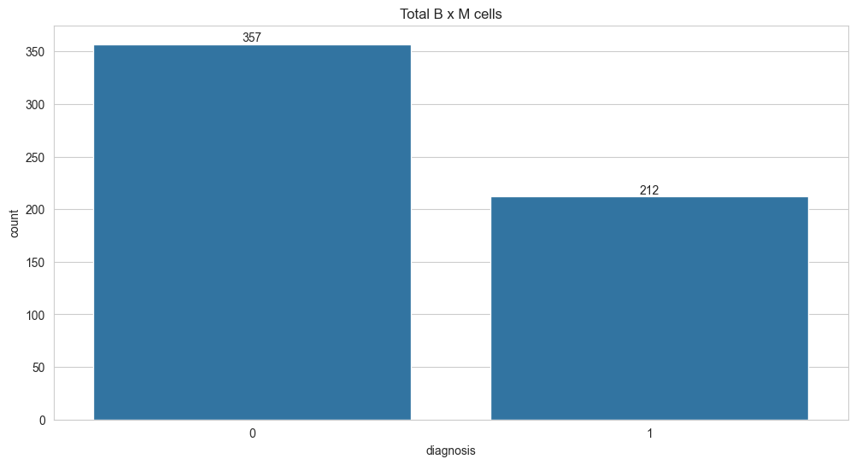
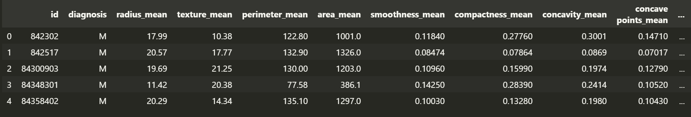
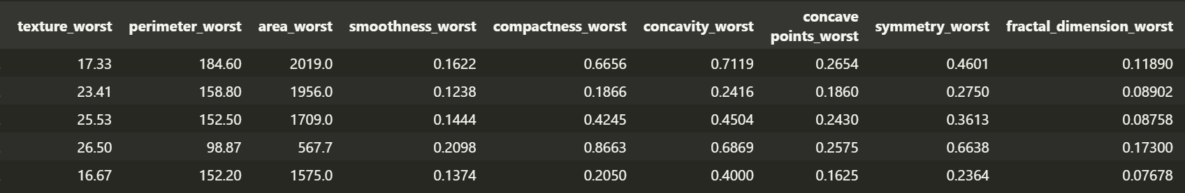
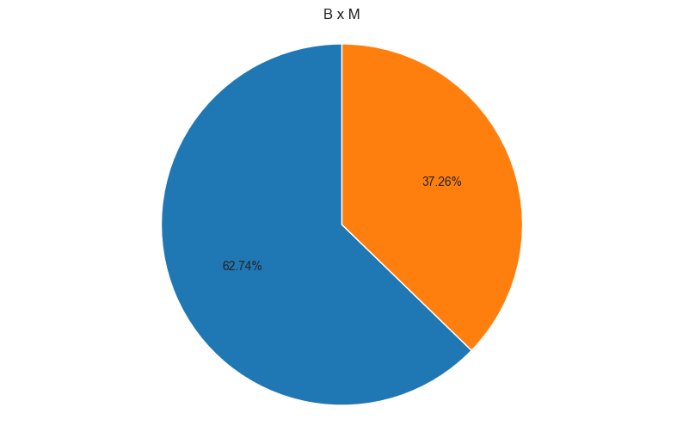
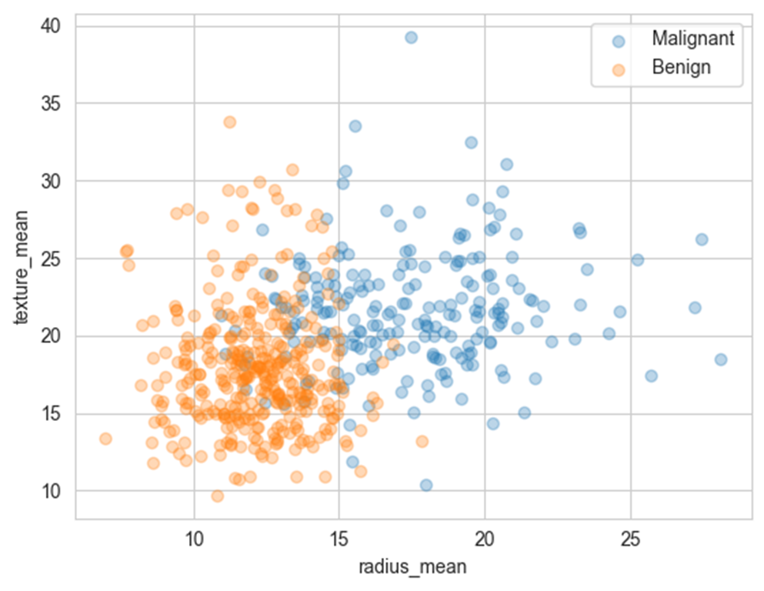
OUTPUT:

Slide 10
Thank You

